Slide 1
TASTE YOUR FUTURE PROGRAM PERFORMANCE THROUGH TO JANUARY 2018

Slide 2
CAMPAIGN UPDATE

Slide 3
WEBSITE + SOCIAL MEDIA UPDATES
Taste Your Future’s Website
127
53,276 +
24,415
Stories
Page Views
Visitors
Taste Your Future’s Social Media Followers
1, 519
60
286

Slide 4
TASTEYOURFUTURE.CA - 2017 RESULTS
In 2017…
268%
compared to 2016
19,064 visitors
(15,604 new)
27,638
page views

Slide 5
SOCIAL MEDIA PERFORMANCE
Highest growth in followers + reach
Most opportunity
Most partner + stakeholder activity

Slide 6
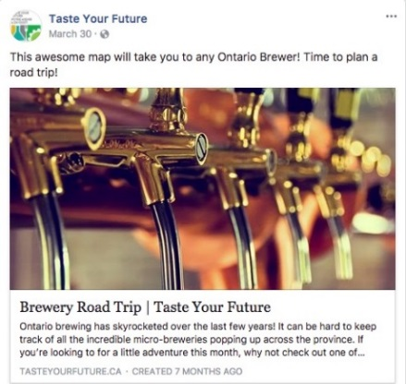
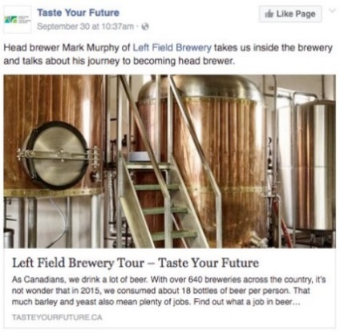
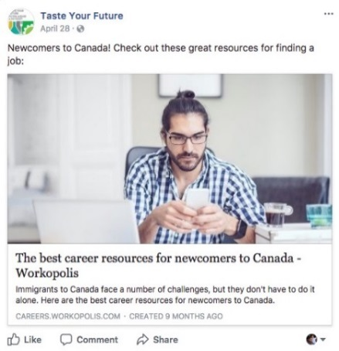
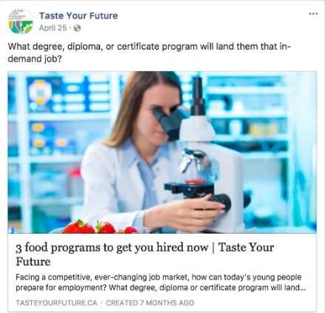
TOP 5 POSTS ON FACEBOOK GENERATING THE MOST ENGAGEMENT

Slide 7
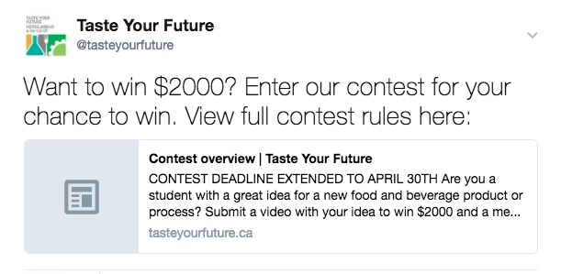
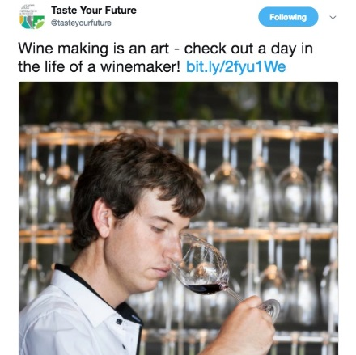
TOP 3 TWEETS ON TWITTER GENERATING THE MOST ENGAGEMENT

Slide 8
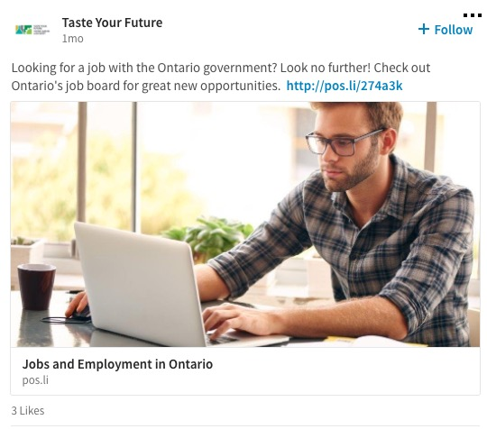
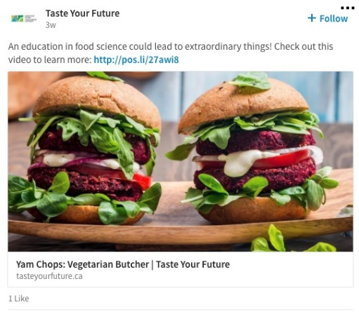
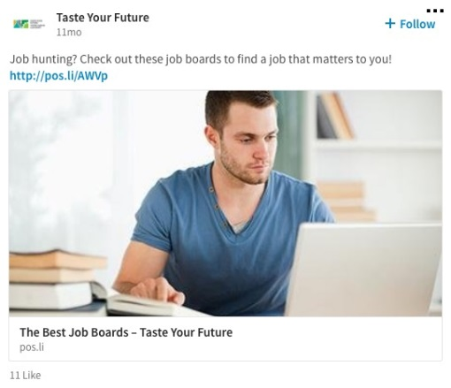
TOP 3 POSTS ON LINKEDIN GENERATING THE MOST ENGAGEMENT

Slide 9
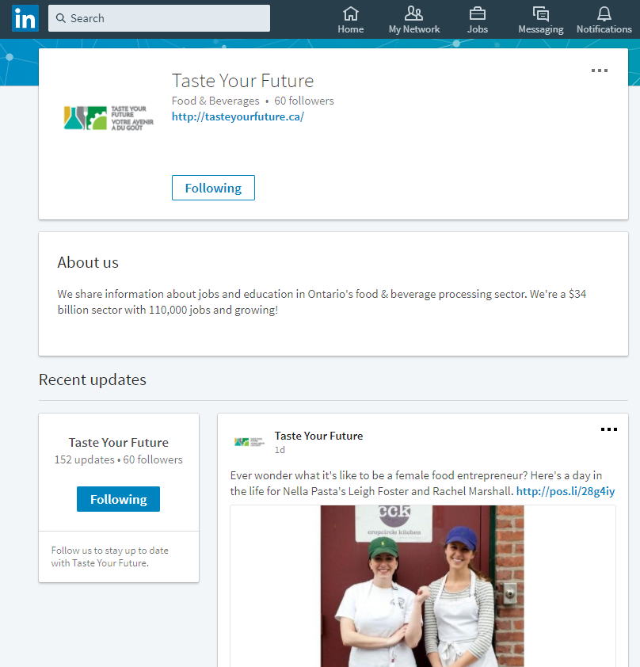
LINKEDIN UPDATE
Launched in 2017
Paid support since Fall 2017
Results
Reach up 300%+
Followers up 300%+
Recommendations for growth:
LinkedIn-specific content can include featured job postings

Slide 10
STAKEHOLDER RELATIONS 2017

Slide 11
ADVERTISING PARTNERSHIPS

Slide 12
Contest open to high school and post-secondary students
Students were asked to create a video showing their idea for a new food and beverage product or process
Two categories:
“Maker and Designer”
“Scientist, Programmer, and Engineer”
The contest was open February to April 2017
STIR UP A CAREER BURSARY CONTEST OVERVIEW

Slide 13
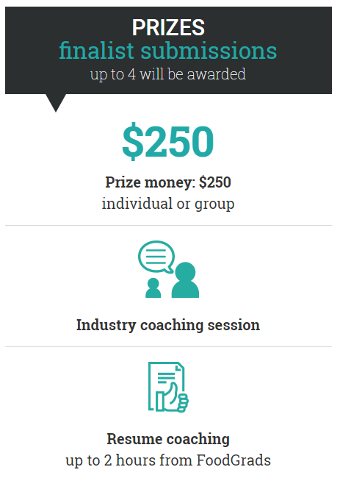
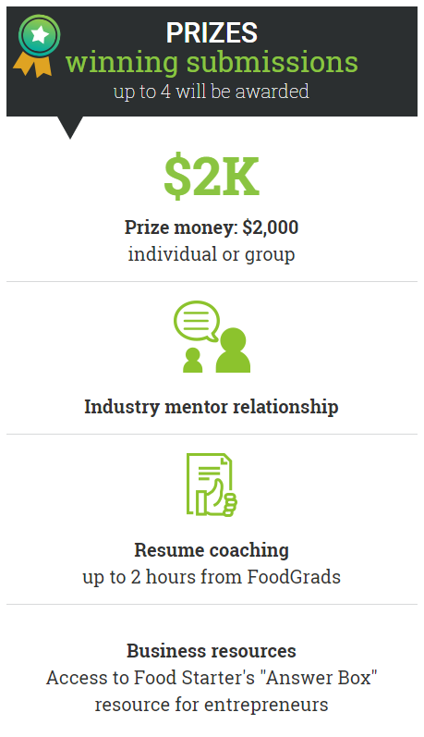

Slide 14
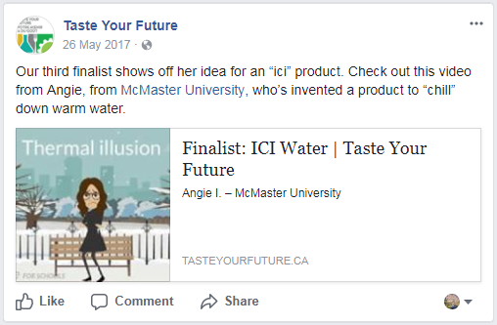
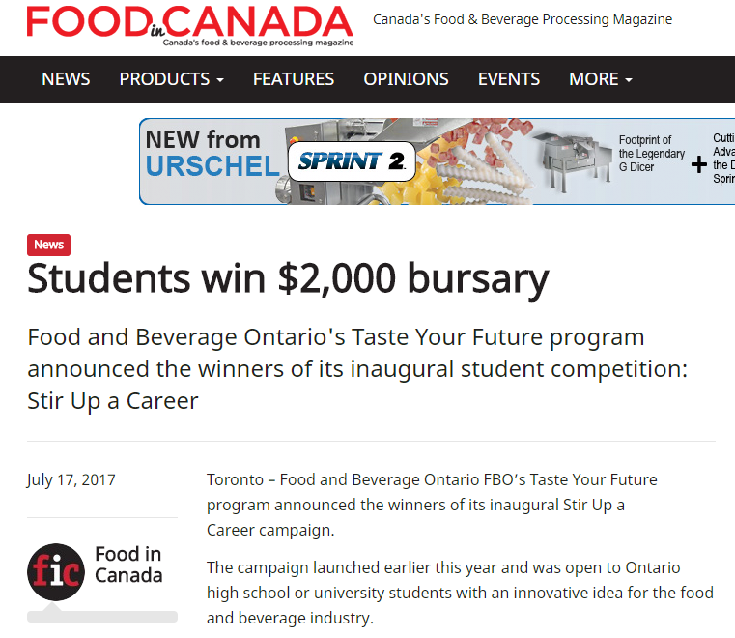
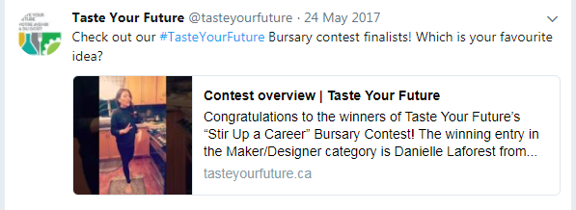
CONTEST PROMOTION

Slide 15
RESULTS!
11,000+ visitors to the contest web page
76% aged 18 – 24
250,000+ people reached (paid + organic)
17 eligible entries, 6 finalists, 2 winners

Slide 16
THE WINNERS…

Slide 17
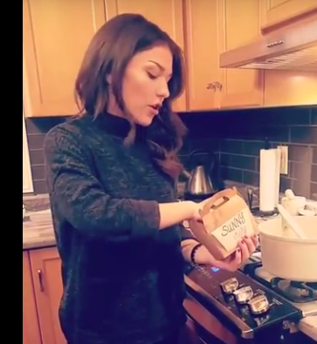
MAKER + DESIGN CATEGORY
Pure Herb
Danielle Laforest
University of Guelph
Notes:
Danielle Laforest, from the University of Guelph Product idea: “Pure Herb.” Danielle’s idea for frozen herbs packaged into meal- and cocktail-themed kits will help reduce food waste and inspire home cooks and cocktail-makers.

Slide 18
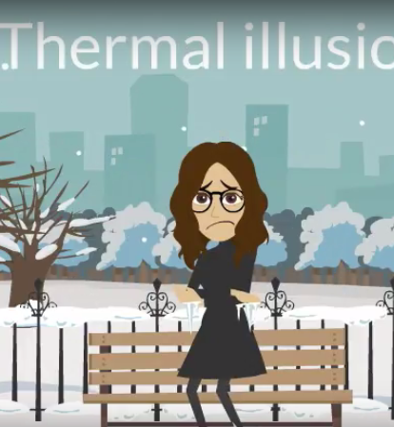
SCIENTIST, PROGRAMER + ENGINEER CATEGORY
CAMPAIGN UPDATE
ICI Water
Angie Ibrahim
McMaster University

Slide 19
CAREER SHOWDOWN!

Slide 20
NEWCOMER WORKSHOP

Slide 21
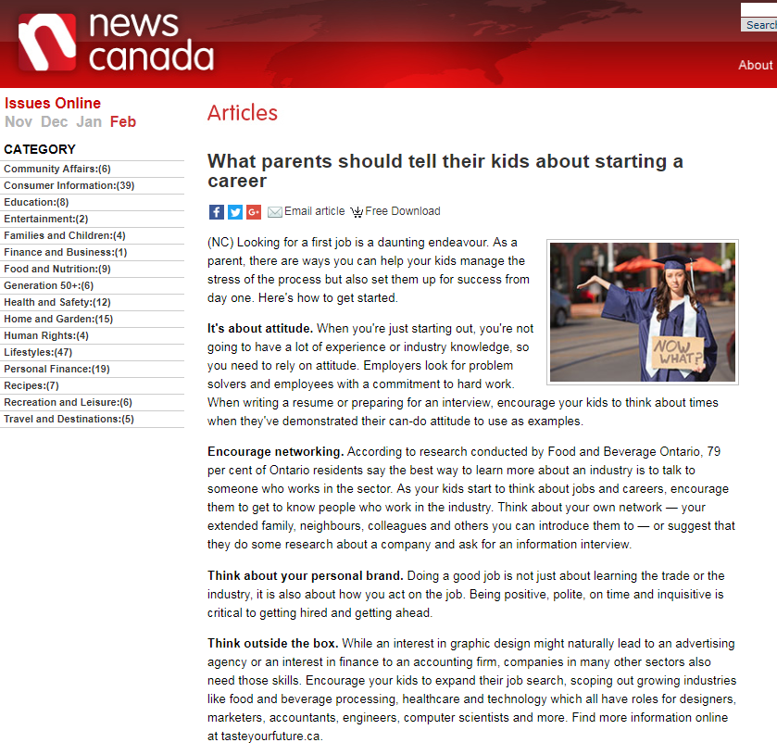
MEDIA RELATIONS
In support of Jan 16th newcomer workshop
Matte Stories on F&B job opportunities

Slide 22
Thank You

